Slide 1
خبر
GROUND-TRUTH OVERSIGHT · HUMANITARIAN OPERATIONS · 2026
Your donors assume funds arrive.
We make sure they do.
خَبَر
khabar
Verified intelligence.
Ground-truth knowledge.
Independent fiduciary oversight, last-mile field verification,
and sovereign liaison — for non-profits and institutional donors
operating in complex environments.
contact@khabaradvisory.com

Slide 2
THE ACCOUNTABILITY GAP
The accountability gap is not a data problem.
30%
$6B
47%
16%
of humanitarian aid estimated lost to fraud, waste & diversion
in annual aid flows assessed as high fiduciary risk
of donors report insufficient field-level outcome verification
of NGO staff say they cannot be fully honest with donors re: militant involvement
UN OIOS / Transparency International
USAID OIG, 2023
ODI Humanitarian Financing Survey
Harvard PILAC / AEI

Slide 3
WHERE THE MONEY GOES
Four ways aid fails before it reaches a beneficiary.
~31%
~19%
Unvetted partner overhead & diversion
Overhead inflation & admin capture
Funds absorbed by intermediaries who passed paper screening but were never verified on the ground — through inflated staff costs, ghost payrolls, or diversion to affiliated parties.
Legitimate-looking operational costs billed at multiples of market rate, or charged to multiple donors simultaneously for the same expenditure.
~21%
~26%
Distribution-point diversion
Ghost beneficiaries & registration fraud
Aid that reaches the site but is redirected before beneficiaries receive it — sold on, reallocated to preferred groups, or removed by armed actors or partner staff.
Beneficiary lists inflated with duplicate registrations, deceased persons, or fictitious names — generating disbursements that go nowhere near a real person.

Slide 4
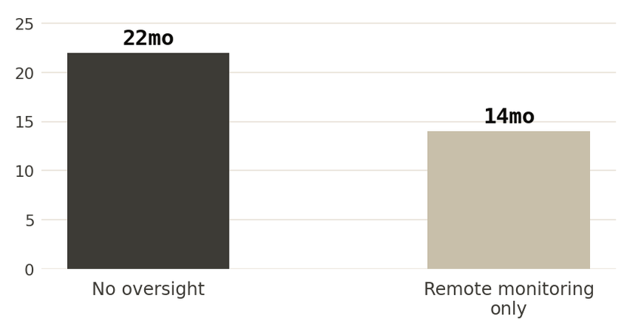
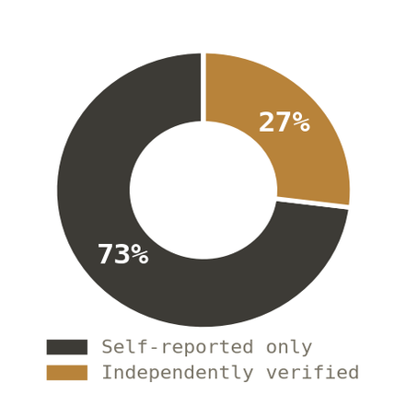
THE DATA BEHIND THE PROBLEM
By the time most donors discover fraud, the money has been gone for over a year.
FRAUD DETECTION LAG
DONOR ACCOUNTABILITY REPORTS
Months from disbursement to discovery
Based solely on implementer-submitted data
Independent field verification catches diversion at the point of distribution — not in an audit two years later.
Nearly 3 in 4 donor reports in conflict zones take the implementer's word for it. No independent eyes. No way to know what actually happened.
USAID OIG fraud investigation timelines (2018–2023); GAO Foreign Assistance fraud analysis (2024)
ODI Humanitarian Financing Survey (2022); Transparency International humanitarian accountability review

Slide 5
WHAT KHABAR DOES
The integrity layer between HQ and the field.
01
02
03
Fiduciary Oversight
Last-Mile Field Verification
Sovereign Liaison
Chain-of-custody tracking from first wire to field receipt. Tranche-based release tied to verified milestones. OFAC and sanctions screening on every partner.
Independent ground-truth confirmation that aid reached its destination. GPS-tagged, timestamped, auditable. Ghost-recipient detection on every engagement.
Direct ministry engagement to secure permits, clear customs, keep corridors open. The right conversation, in the right language, at the right level.
04
05
06
Partner Vetting
Ready-File Retainer
Donor Accountability Reporting
Four-phase due diligence: legal integrity, operational capacity, political neutrality, financial controls. We go to their world, not just their paperwork.
Pre-crisis preparedness on retainer. Warm partner files and legal frameworks maintained for high-risk regions. Deploy in hours, not weeks.
Board-ready documentation after every engagement — forensic audit, impact verification, and the evidence your next fundraising round depends on.

Slide 6
PARTNER VETTING METHODOLOGY
Four phases. No shortcuts.
Every partner runs the same framework — regardless of the urgency on the ground.
I
II
III
IV
THE PAPER TRAIL
THE CAPABILITY TRAIL
THE SOCIAL TRAIL
THE MONEY TRAIL
Institutional Integrity
Operational Stress Test
Ground-Truth Inquiry
Fiduciary Guardrails
Sanctions screening, legal standing, governance review. We establish who the partner actually is before anything else moves.
Physical assets, staff headcount, access routes. Do they own what they claim — and can they move in the mud.
Ecosystem interviews, neutrality assessment, shadow verification of prior distributions. We ask their world, not just them.
Segregated accounts, tranche controls, anti-bribery protocols — before the first dollar moves.

Slide 7
OPERATIONAL EXPERIENCE
ACTIVE SERVICE CORRIDORS
Tested in the field.
Not in a boardroom.
MENA Region
Arabic · Farsi · Turkish
Latin America
"The gap between what donors believe is happening and what is actually happening in the field is not a data problem. It is an accountability problem. We fix that."
Spanish
Eastern Europe
Russian
East Africa
— Khabar Advisory, founding principle
Partner network
MENA
Large-scale displacement response
West Africa
Oversight and government liaison for a coordinated multi-partner response serving 10,000+ displaced civilians.
Partner network
PROCESS
SOP development across organizations
CRISIS TYPES
Protocols adopted across a multi-organization humanitarian response, aligning international bodies with local implementing partners.
Mass displacement
Evacuation ops
ACCESS
Direct Ministry engagement
Famine response
Natural disaster
Engagement with Ministry officials to secure operational permissions and maintain humanitarian access during active crisis conditions.
Conflict zones
Refugee camp mgmt
Medical emergency

Slide 8
HOW WE ENGAGE
Three ways to work with Khabar.
01 · PROJECT
02 · PROGRAMME
03 · RETAINER
Single Engagement
Programme Oversight
Ready-File Retainer
Contact for Pricing
Contact for Pricing
Contact for Pricing
Ideal for one-time vetting, a specific field verification, or a post-action audit.
Ideal for active grant cycles requiring ongoing monitoring across multiple partners or sites.
Ideal for organisations in high-risk regions who need to deploy fast when a crisis hits.
—
Partner vetting report (one partner)
—
Up to 4 field verification visits
—
Pre-vetted partner files maintained
—
Field verification visit (one site)
—
Monthly financial reconciliation
—
Quarterly network refresh
—
Donor accountability report
—
Partner vetting (up to 3 partners)
—
On-call advisory hours (8 hrs/mo)
—
30-day evidence retention
—
Quarterly donor report
—
First-right rapid deployment
—
Dedicated analyst point of contact
—
Legal framework on standby

Slide 9

WHAT HAPPENS NEXT
Most organisations wait until something goes wrong. Don't.
30-Minute Conversation
Scoping & Proposal
NDA Signed. Work Begins.
Tell us about your operation — the region, the partners, the timeline, and what keeps you up at night. No pitch, no obligation. We'll tell you plainly whether and how we can help.
Within 5 business days we'll send a tailored scope of work with fixed fees, a clear timeline, and the exact deliverables you'll receive. No retainer required to receive a proposal.
Once agreed, we execute the NDA and MSA, assign your lead analyst, and begin work. For urgent deployments we can be operational within 48 hours of agreement.
Book via contact@khabaradvisory.com
Proposal delivered within 5 days
Operational within 48 hrs if urgent
Your next operation. Done right, from the first dollar.

